Slide 1
Heat Transfer:
Physical Origins and
Rate Equations
Chapter One
Sections 1.1 and 1.2

Slide 2
Heat Transfer and Thermal Energy
What is heat transfer?
Heat transfer is thermal energy in transit due to a temperature
difference.
What is thermal energy?
Thermal energy is associated with the translation, rotation,
vibration and electronic states of the atoms and molecules
that comprise matter. It represents the cumulative effect of
microscopic activities and is directly linked to the temperature
of matter.

Slide 3
Heat Transfer and Thermal Energy (cont.)
DO NOT confuse or interchange the meanings of Thermal Energy, Temperature and Heat Transfer
Quantity | Meaning | Symbol | Units
Thermal Energy⁺ | Energy associated with microscopic behavior of matter
Temperature | A means of indirectly assessing the amount of thermal energy stored in matter
Heat Transfer | Thermal energy transport due to temperature gradients
Heat | Amount of thermal energy transferred over a time interval  t > 0
Heat Rate | Thermal energy transfer per unit time
Heat Flux | Thermal energy transfer per unit time and surface area

Slide 4
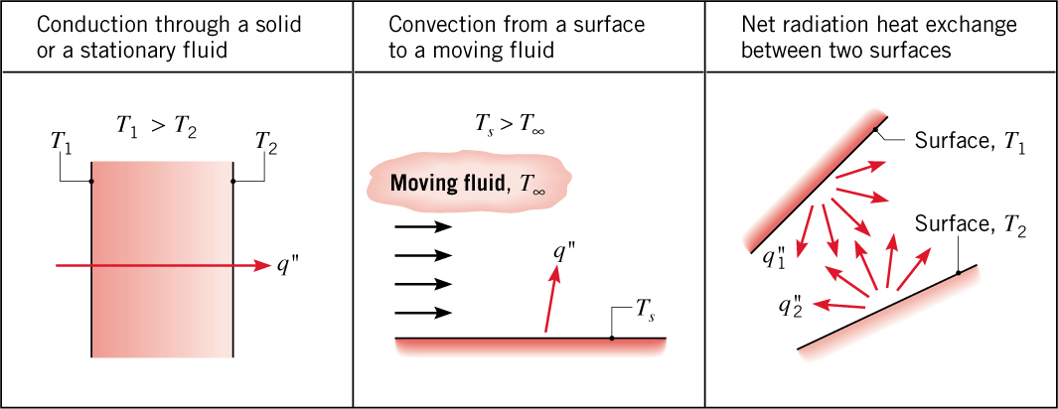
Modes of Heat Transfer
Modes of Heat Transfer
Conduction: Heat transfer in a solid or a stationary fluid (gas or liquid) due to
the random motion of its constituent atoms, molecules and /or
electrons.
Convection: Heat transfer due to the combined influence of bulk and
random motion for fluid flow over a surface.
Radiation: Energy that is emitted by matter due to changes in the electron configurations of its atoms or molecules and is transported as
electromagnetic waves (or photons).
Conduction and convection require the presence of temperature variations in a material
medium.
Although radiation originates from matter, its transport does not require a material
medium and occurs most efficiently in a vacuum.

Slide 5
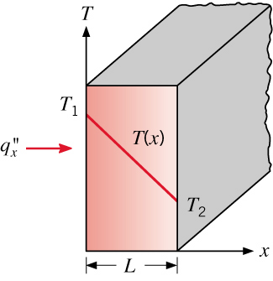
Heat Transfer Rates: Conduction
Heat Transfer Rates
Conduction:
General (vector) form of Fourier’s Law:
Heat flux
Thermal conductivity
Temperature gradient
Application to one-dimensional, steady conduction across a
plane wall of constant thermal conductivity:
(1.2)
Heat rate (W):

Slide 6
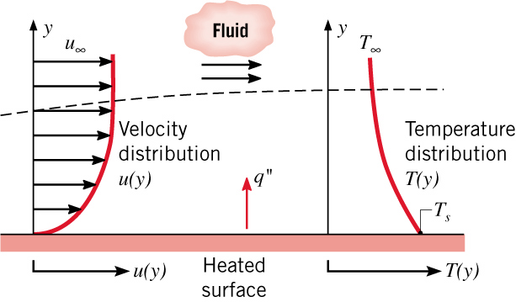
Heat Transfer Rates: Convection
Heat Transfer Rates
Convection
Relation of convection to flow over a surface and development
of velocity and thermal boundary layers:
Newton’s law of cooling:
(1.3a)

Slide 7
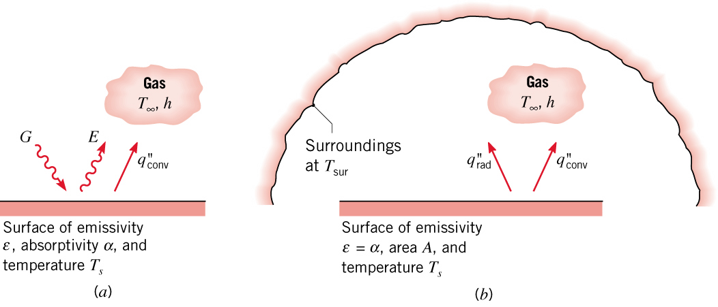




Heat Transfer Rates: Radiation
Heat Transfer Rates
Radiation
Heat transfer at a gas/surface interface involves radiation
emission from the surface and may also involve the
absorption of radiation incident from the surroundings
(irradiation, ), as well as convection
Energy outflow due to emission:
(1.5)
Energy absorption due to irradiation:

Slide 8

Heat Transfer Rates Radiation (Cont.)
Heat Transfer Rates
Irradiation: Special case of surface exposed to large
surroundings of uniform temperature,
(1.7)

Slide 9

Heat Transfer Rates: Radiation (Cont.)
Heat Transfer Rates
Alternatively,
(1.8)
(1.9)
For combined convection and radiation,
(1.10)

Slide 10
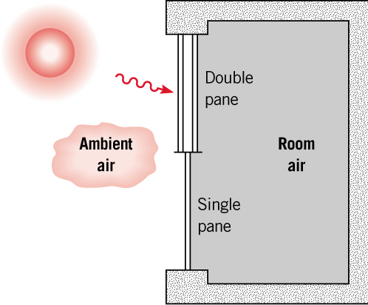
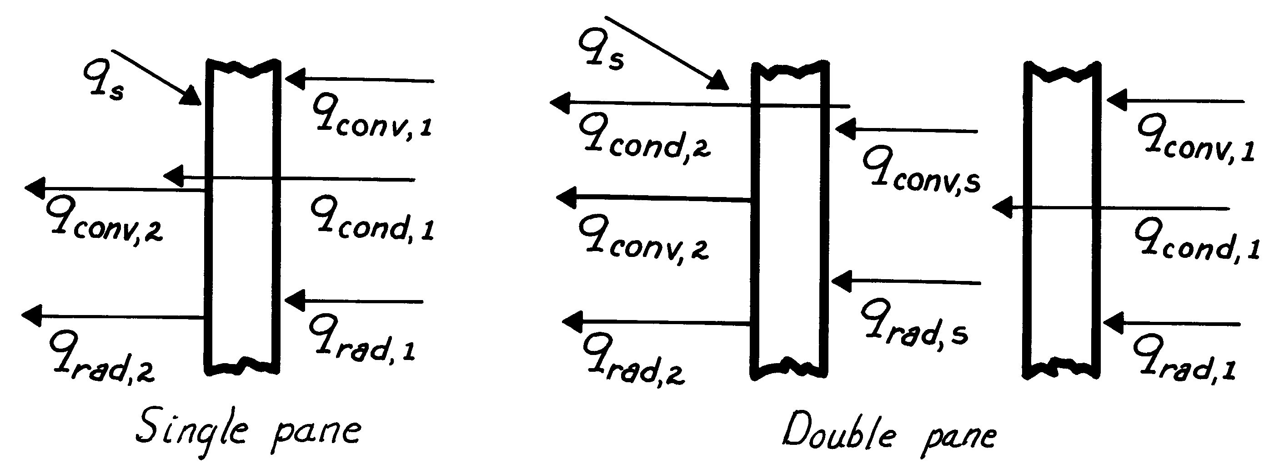









Process Identification
Problem 1.73(a): Process identification for single-and double-pane windows
Schematic:
Convection from room air to inner surface of first pane
Net radiation exchange between room walls and inner surface of first pane
Conduction through first pane
Convection across airspace between panes
Net radiation exchange between outer surface of first pane and inner surface of second pane (across airspace)
Conduction through a second pane
Convection from outer surface of single (or second) pane to ambient air
Net radiation exchange between outer surface of single (or second) pane and surroundings such as the ground
Incident solar radiation during day; fraction transmitted to room is smaller for double pane

Slide 11
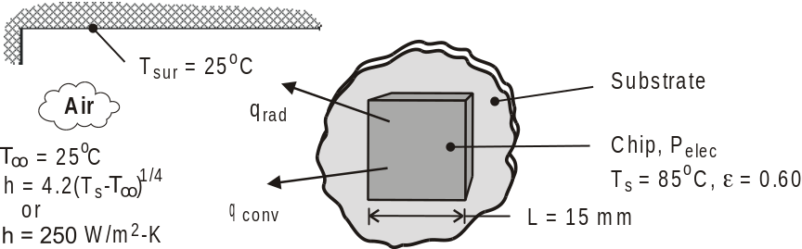
Problem: Electronic Cooling
Problem 1.31: Power dissipation from chips operating at a surface temperature
of 85°C and in an enclosure whose walls and air are at 25°C for (a) free convection and (b) forced convection.
Schematic:
Assumptions: (1) Steady-state conditions, (2) Radiation exchange between a small surface and a large enclosure, (3)
Negligible heat transfer from sides of chip or from back of chip by conduction through the substrate.
Analysis:
(a) If heat transfer is by natural convection,
(b) If heat transfer is by forced convection,

